Slide 1

Application of Game Theory in Network Security
SHOBHIT
19CS06008
M.TECH 1ST YEAR
COMPUTER SCIENCE AND ENGINEERING
Under the guidance of :
Dr. Padmalochan Bera
Notes:
As networks become ubiquitous in people’s lives, users depend on networks a lot for sufficient communication and convenient information access.However, networks suffer from security issues. Network security become a challenging topic since numerous new network attacks have appeared increasingly sophisticated and caused vast loss to network resources. Game theoretic approaches have been introduced as a useful tool to handle those tricky network attacks.

Slide 2
Outline:
Traditional Network Security Solutions and it’s limitation
Game theory and types of games
Non-Cooperative game example
Cooperative game example
Classification of Game Theory Application in Network Security
Static Bayesian Game
Application of network security assessment
Conclusion
Notes:
These are the contents which we will see in this seminar

Slide 3
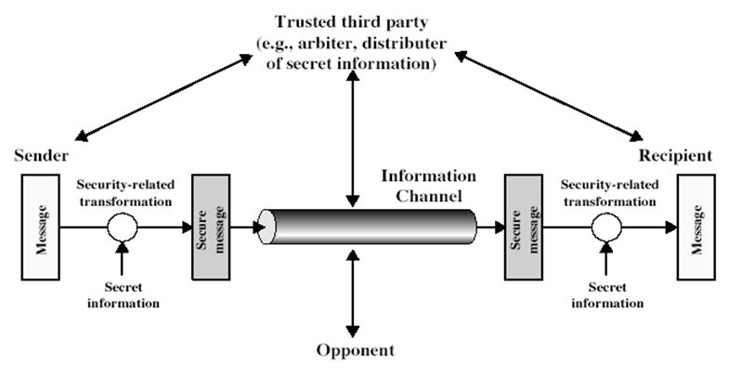
Traditional Network Security Solutions.
Intrusion Detection System
Antivirus And Antimalware Software
Firewall Protection
Virtual Private Networks
Generic Security Model
Notes:
Intrusion Detection System: An IDS is a reactive system that is used to monitor events occurring in a network or computer system. Methods of Signature Detection, Pattern Recognition. These are of two types 1. Signature based and 2. Anomaly based
Antivirus and Antimalware Software: Antivirus and antimalware software protect an organization from a range of malicious software.
Firewall Protection: Firewalls are some policies which act as a barrier between the untrusted external networks and your trusted internal network
Virtual Private Networks: Virtual private networks (VPNs) create a connection to the network from another endpoint or site. VPNs typically allow only authenticated remote access using tunneling protocols and encryption techniques

Slide 4

Limitations of Intrusion Detection System
False Alarms
Limitations of Analytical Module
Source Addresses
Encrypted Packets
Notes:
False Alarms:The disadvantage is that the intrusion software can create a large number of false alarms. These false alarms are increased on networks where there are a large number of users.
Limitations of Analytical Module: While an IT professional monitoring the system will be alerted that abnormal behavior has been detected they won't be able to tell where the behavior originated from. The response to this information can only be to try and stop the unauthorized network access.
Source Addresses: IDS provides information based on the network address that is associated with the IP packet that is sent into the network. This is beneficial if the network address contained in the IP packet is accurate.
Encrypted Packets: The encrypted packet can allow an intrusion to the network that is undiscovered until more significant network intrusions have occurred.

Slide 5



Game Theory:
The study of strategic decision making.
Game theory is a mathematical tool used to describe and solve games.
A Game includes the interactions between entities in any situation.
There are four basic elements used to describe a game.
1.Players
2.Actions
3.Payoff
4.Strategies
Notes:
A game is any interaction between Multiple people in which each person’s payoff is affected by the decisions made by others
Players:The entities involved in the Game . These entities can be people, institutions or any other things that can interact with each other.
Actions: In each move of a player , he/she takes an actions
Payoff:After all of the players have taken actions in the game, each of them will get either a negative or positive return
Strategies: A player’s strategy is his/her plan of action that specifies which action to take based on his/her knowledge of the action history. Strategies can be pure or mixed.

Slide 6
Types of Games:
Based on nature of players
Based on knowing payoffs of the players
Based on the knowing action of players
Based on stages
Co-operative
Perfect Information
Complete Information
Static
Game Models
Imperfect Information
Non Co-operative
Perfect Information
Incomplete Information
Dynamic
Imperfect Information
Notes:
Non-cooperative:if entities interact competitively ,When you’re competing with others, it makes sense to choose the course of action that benefits you the most no matter what everyone else decides to do
Cooperative game:if entities interact cooperatively when every player has agreed to work together toward a common goal
Complete information: Every player in the game knows all player’s payoff functions.ex:prisoners dilemma
Incomplete information: at least one of the players does not know all player’s payoff functions.
Perfect Information: Each player knows all the previous actions of players when he/she takes his/her move ex: chess game
Imperfect Information: at least one player doesn’t know all of the previous actions. When he/she takes his/her move
Static/strategic Game: is the one-shot game in which players take actions at the same time. A static game can be viewed as a game of imperfect information since, at each time , only one player takes his/her move.
Dynamic/Extensive Game: is a game consisting of multiple stages or moves.

Slide 7
Lets See an Example of Static Complete Perfect Game!
(Prisoner’s Dilemma)

Slide 8
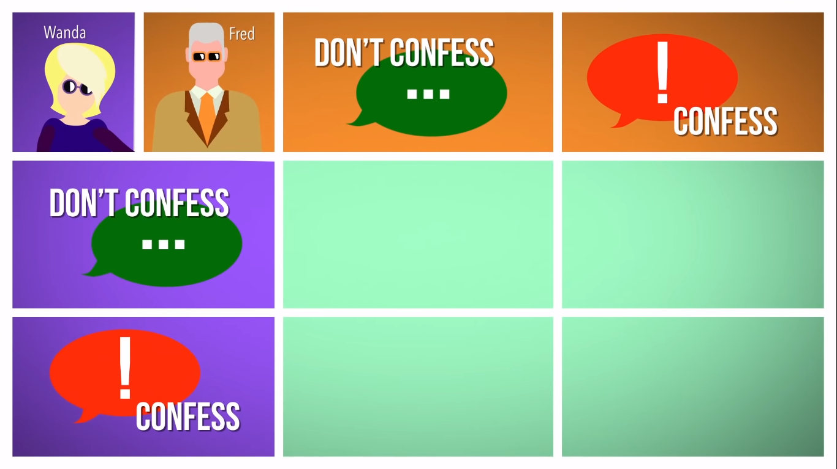
Notes:
We will setup this game into the grid.let us consider two players wanda and fred. Wanda and fred were arrested fleeing from the scene of a crime, and based on the evidence the police have already collected, they’re going to have to spend two years in jail.so DA wants more

Slide 9
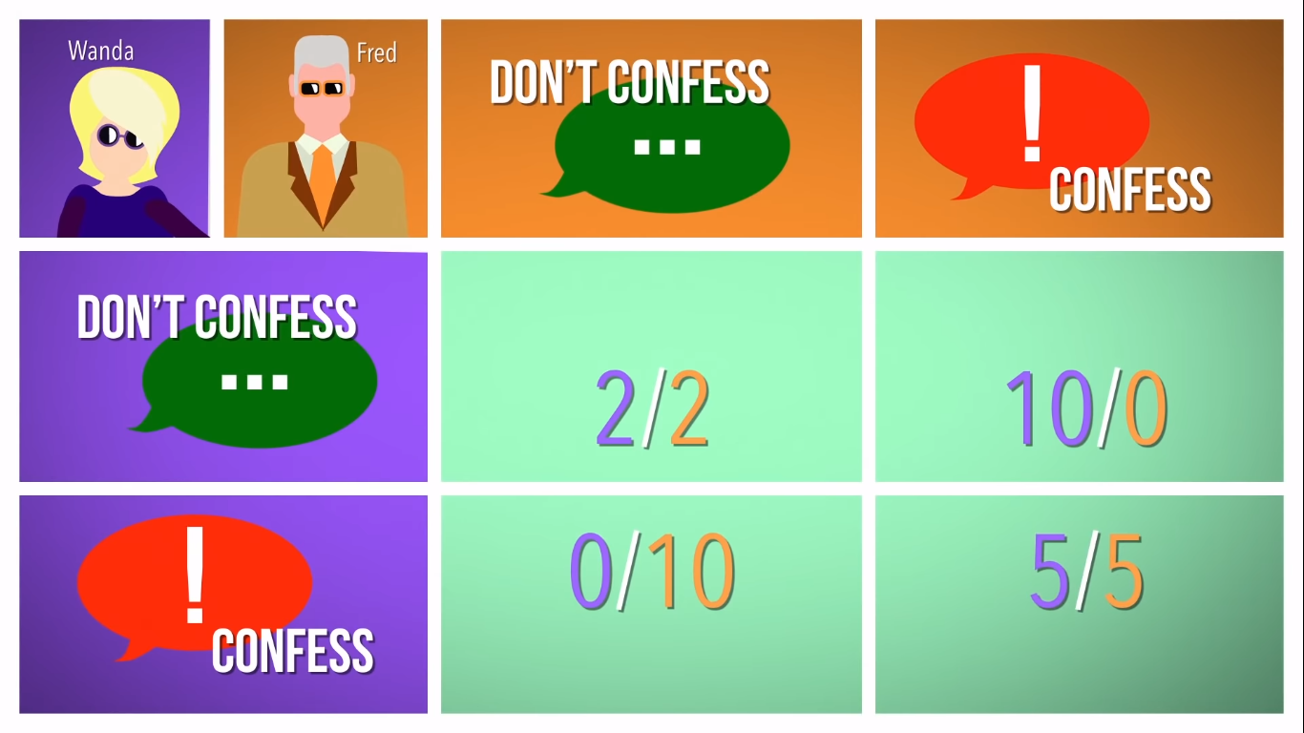
Notes:
If you confess to the crime and your partner does not you’ll be granted immunity.your partner, though, will serve 10 years in jail.
If you both confess then you will both end up spending 5 years in jail.
But if neither of you confess, you’ll both spend only 2 years in jail.
Wanda and fred are split up and they don’t know what their partner is going to do. They don’t have loyalty to each other.

Slide 10
A Player in a Game has found Nash Equilibrium
when they make the choice that leaves them better off no matter what their opponents decide
Notes:
To find the solution of this game we use Nash Equilibrium.

Slide 11
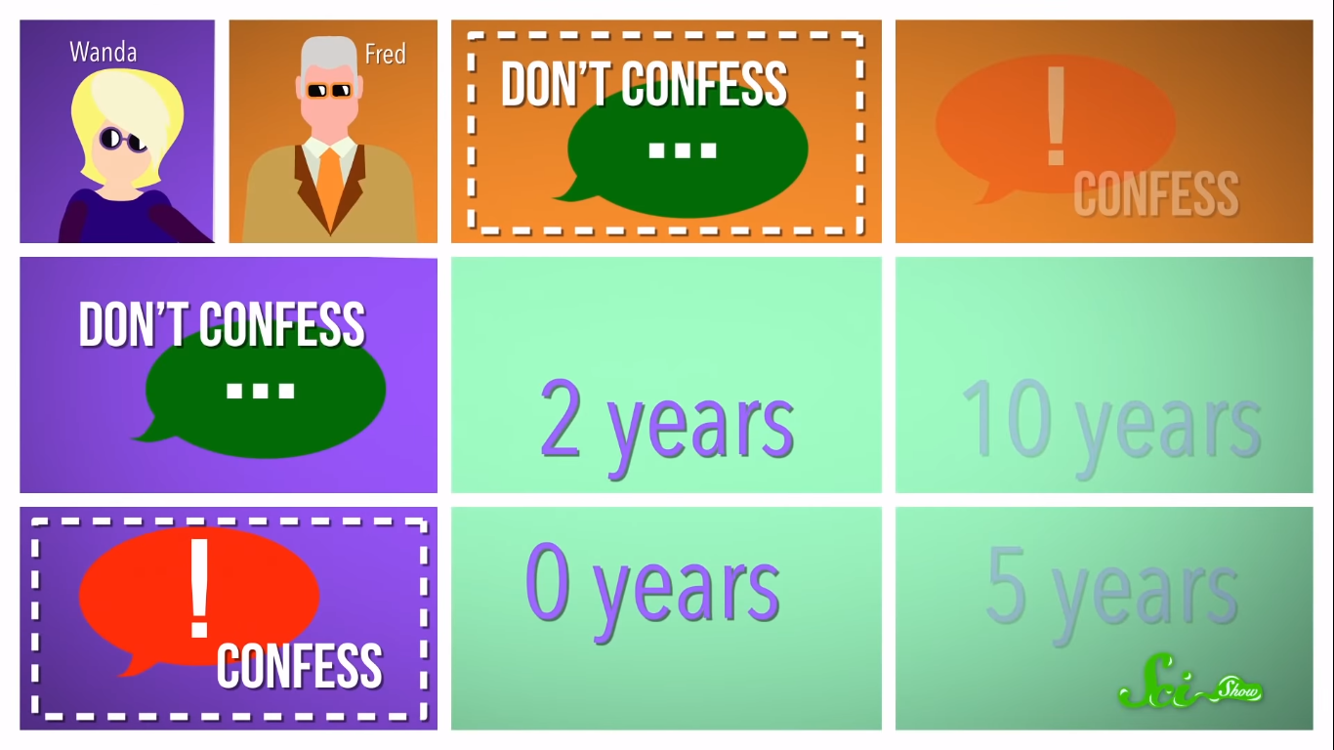

Slide 12


Slide 13


Slide 14

Notes:
But if she decides not to confess, and fred keeps his pinky promise too,they both get 2 years of jail but they can’t trust each other.

Slide 15
Cooperative Game:
Players agreed to work towards a common goal called coalition.
Shapley Value - The method of dividing cost or gain amongst players based on their contributions.
The contributions of each player is calculated by removing others from game. This is called marginal value.
Example: If a group produces 50 less cookies everyday when you were not there, then your marginal value is 50 cookies.

Slide 16

Notes:
Let us consider that each cookies of 1 dollar and now we have to divide loot fairly.
In first case My contribution to the coalition is 10 cookies and in second case my contribution to the coalition is 20 cookies then we will take avg of both of them i.e (10+20)/2 = $15 and my friend will get $25

Slide 17
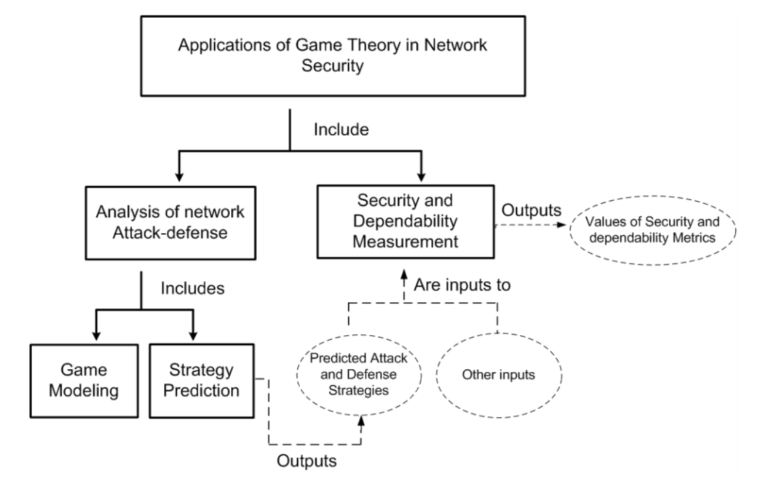
Classification of Game Theory Application
In Network Security
Fig. 1. Relationship among game theory applications in network security
Notes:
Attack-Defense:modelling the interaction between attackers and defenders as games, predicting the actions of the attackers and determining the responding defense strategy.
Security and Dependability measure: predicting the strategies of attackers and defenders and evaluating the security of the system based on this prediction.
Other inputs like network parameters.

Slide 18
Now we will map this concept to Actual real scenario.

Slide 19
Static Bayesian Game
We consider a two player static Bayesian game. One player is defender and the other is potentially an attacker.
The defender has two true strategies: Monitor and Non - Monitor. Defender is equipped with IDS.
The attacker has two true strategies: Attack and Not Attack.
The regular player has one strategies: Not Attack.
Notations in this game:
𝝰 - Detection Rate
𝛃 - False Detection Rate
w - loss of security whose value can compared to monetary, resources.
C_{m} - cost of monitoring by defender.
C_{a} - cost of attacking by attacker.
Notes:
Every defender is equiped with IDS

Slide 20
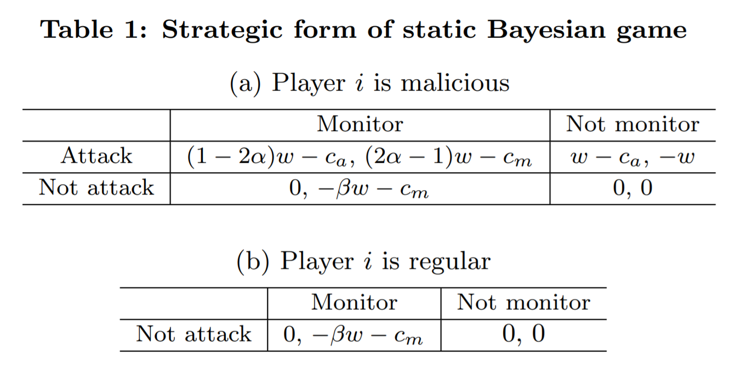

Slide 21
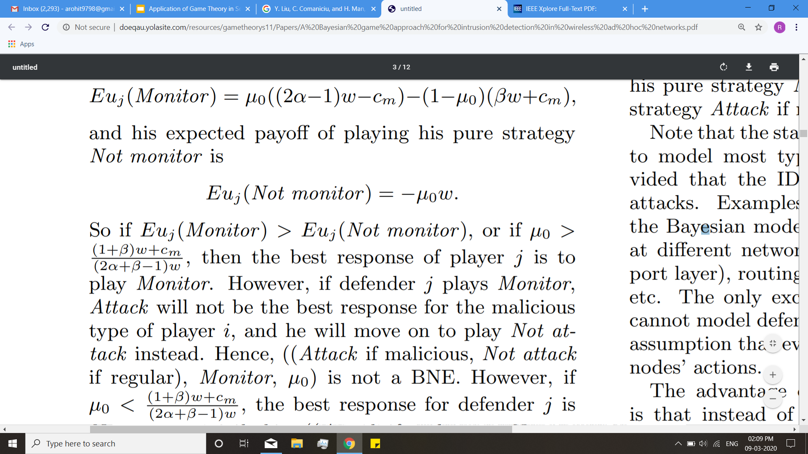
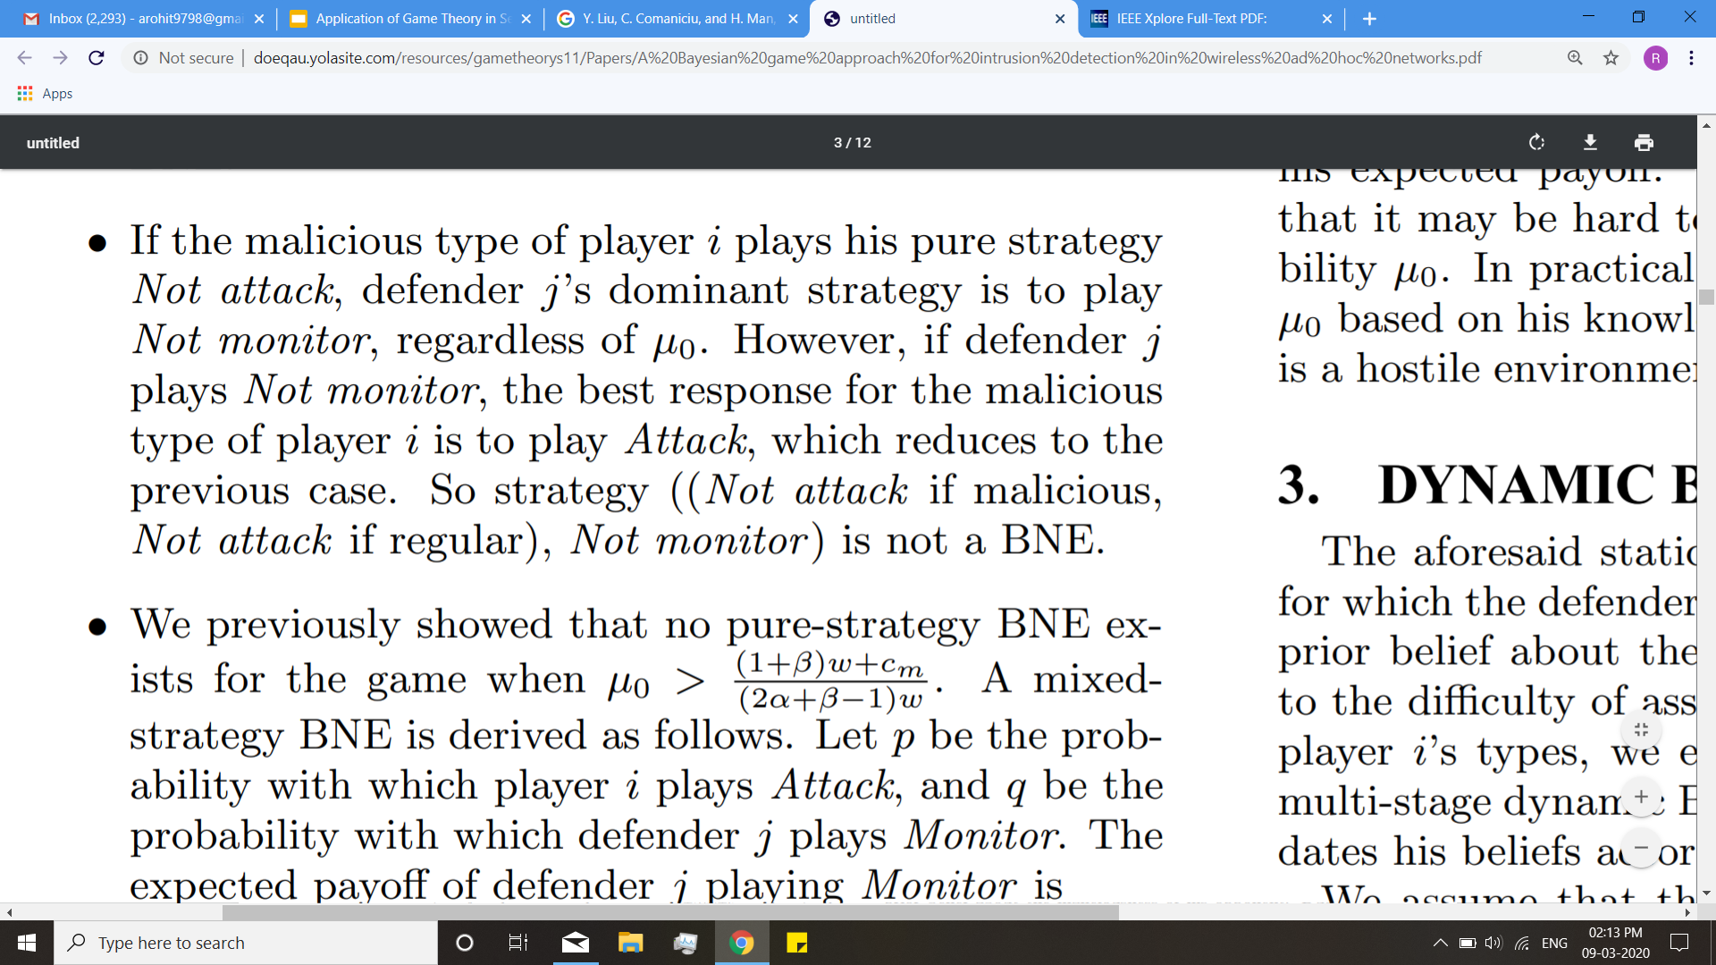
((Attack if malicious, not attack if regular), Monitor) is not a BNE.
((Attack if malicious, not attack if regular), Not Monitor) is a BNE.

Slide 22
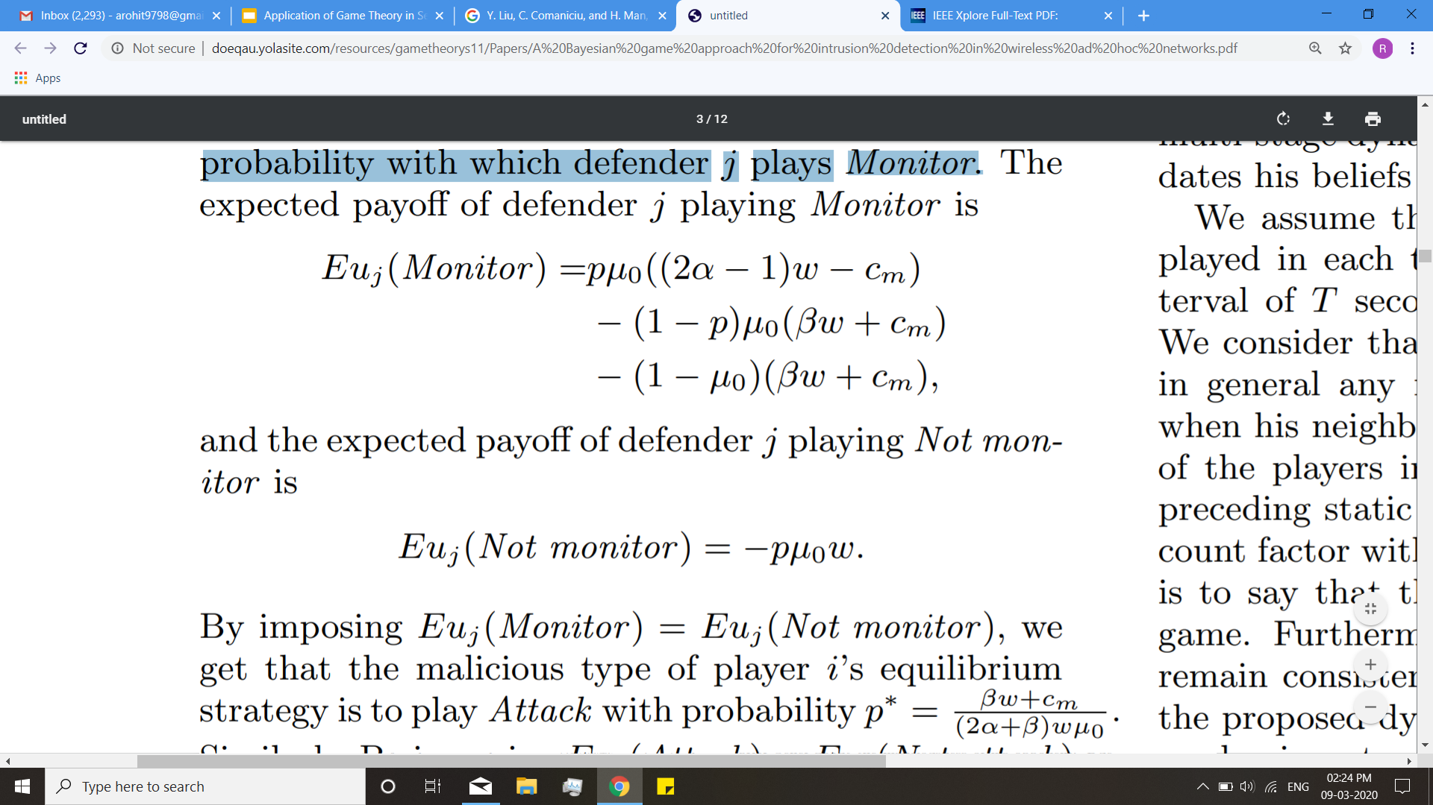
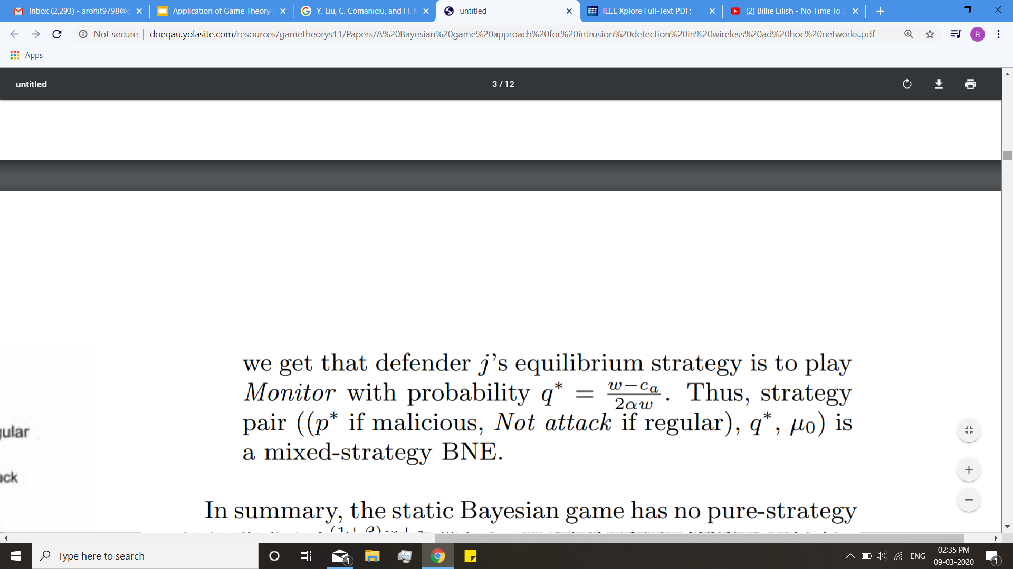
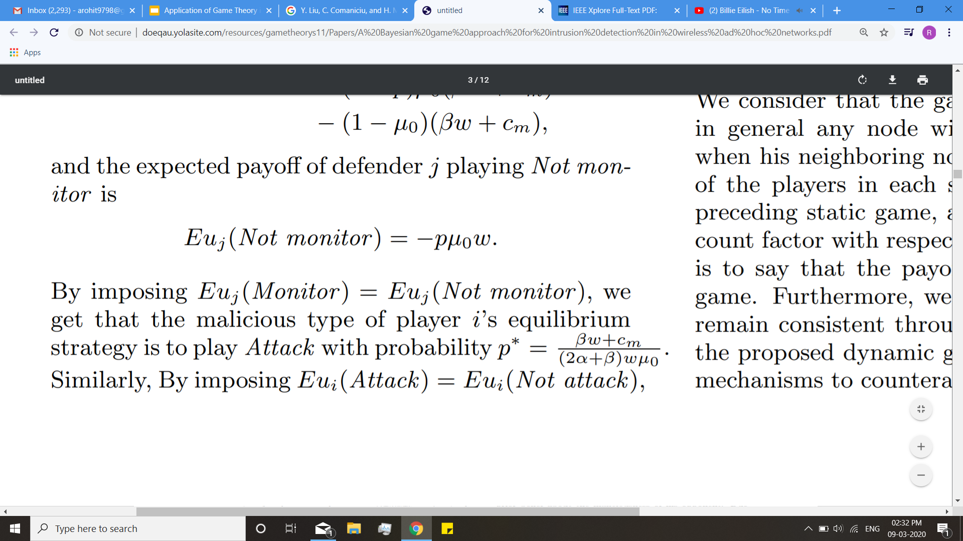
Therefore there is no BNE for case 1
So to generate BNE we would consider mixed strategy BNE,
Let p be the probability with which player i plays Attack, and q be the probability with which defender j plays Monitor.
Thus, strategy pair ((p∗ if malicious, Not attack if regular), q∗) is a mixed-strategy BNE.

Slide 23
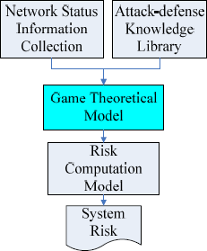
Application of Network Security Assessment
Security is a concept concerned with confidentiality ,integrity,reliability, and availability.
Metrics for security and dependability measurement:
Mean time to failure (MTTF).
Mean time to first failure (MTFF).
Mean time between failures (MTBF).
Price of Anarchy (POA).
Notes:
Mean time to failure (MTTF) is the length of time a device or other product is expected to last in operation in unrecoverable system.
MTBF: it is the length of time between any two consecutive failure in a recoverable system.
MTFF: the mean time to first failure in the recoverable system
Price of Anarchy(POA) is a concept is measure how the system is degrades due to selfishness of the agent. So, it is the ratio between non-cooperative and cooperative way of solving the task

Slide 24
Conclusion
We have seen a Bayesian game formulation,In this each player tries to maximize its payoff.
The attacker seeks to inflict the most damage in the network without being detected.
While the defender tries to maximize his defending capabilities with a constraint on its energy expenditure for heavy traffic monitoring using IDS, and without complete information on the type of his opponent.
We have shown that the static game leads to a mixed-strategy BNE when the defender’s belief of player i being malicious is high and to a pure-strategy BNE when the defender’s belief of player i being malicious is low.
Thus game theory can be applied to network security to analyze the different strategies, actions and calculate the security measurement regarding the model.

Slide 25
References
[1]X. Liang and Y. Xiao, "Game Theory for Network Security," in IEEE Communications Surveys & Tutorials, vol. 15, no. 1, pp. 472-486, First Quarter 2013.
[2]S. Roy, C. Ellis, S. Shiva, D. Dasgupta, V. Shandilya and Q. Wu, "A Survey of Game Theory as Applied to Network Security," 2010 43rd Hawaii International Conference on System Sciences, Honolulu, HI, 2010, pp. 1-10.
[3]Y. Liu, C. Comaniciu, and H. Man, “A bayesian game approach for intrusion detection in wireless ad hoc networks,” In Proc. 2006 workshop on Game theory for communications and networks, 2006.
[4]W. He, C. Xia, H. Wang, C. Zheng, and Y. Ji, “A game theoretical attack-defense model oriented to network security risk assessment,” 2008 International Conference on Computer Science and Software Engineering, pp. 498 - 504, 2008.

Slide 26
Any Questions….

Slide 27
THANK YOU

